Slide 1
ANITA
Update 11FEB2020

Slide 2
Anita information collection process
Phase 1
Import & sort files
Phase 2
Scrape (new) files
Phase 3
Merge with existing information
Phase 4
Export JSON / DF

Slide 3
Phase 1 Import & sort files
New folder
Check dates
Create structure
Check market folder (if not: create market folder)
Move & pass on data
Move files
Return list of moved files
If no date exists: ask user
Check date folder (if not: create date folder)
Add date to file names

Slide 4
Phase 1 Import & sort files
New folder
Check dates
Check market folder (if not: create market folder)
Move files
Return list of moved files
If no date exists: ask user
Check date folder (if not: create date folder)
Move & pass on data
Create structure
In file name?
Does file name start with 02_11_2020?
In folder?
Folder that starts with 02_11_2020? (whole structure)
If not: ask user
Ask date
Ask if this date applies to all files

Slide 5
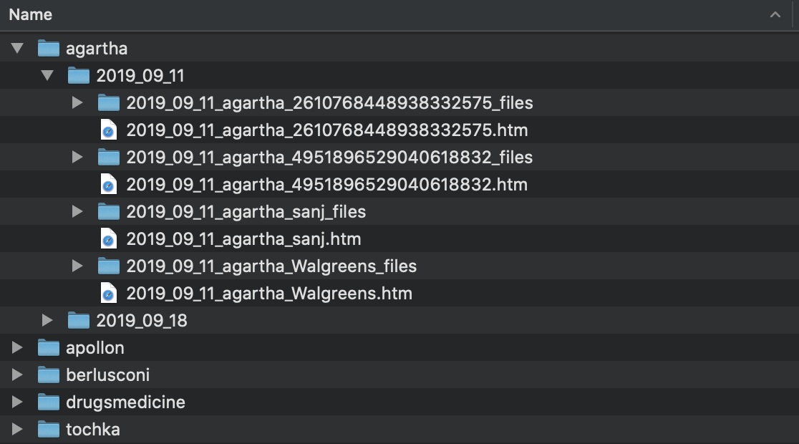
Phase 1 Import & sort files

Slide 6
Phase 1 Import & sort files
Demo?

Slide 7
Phase 1 Import & sort files
Q:
Dealing with date good now?
How far do I need to work out the importing?
Also ZIP file extractions etc?
To do:
Removing of folders
Further checking
Add Berlusconi Australian guy data

Slide 8
Phase 2 Scrape files
Scrapes per file (not per product or vendor)
Now in data:
Agartha
Apollon
Berlusconi
Drugs & Medicine
Tochka
Have not looked at the other markets & more data yet

Slide 9
Phase 2 Scrape files – Scraped features
Product:
Product_name
Vendor
Ships_from
Ships_to
Price
Info
Vendor:
Vendor_name
Score
registration
Las_login
Sales
Info
Product feedback:
Score
Message
Date
User
Vendor feedback:
Score
Message
Date
Product
User
Deals

Slide 10
Phase 2 Scrape files – Extracted features
Product:
Product_name
Vendor
Ships_from
Ships_to
Price
Price_eur
Info
Feedback
Vendor:
Vendor_name
Score
Score_normalized
Registration
Registration_normalized
Last_login
Last_login_normalized
Sales
Info
Feedback
Product
feedback:
Score
Message
Date
User
Vendor
feedback:
Score
Message
Date
Product
User
Deals

Slide 11
Phase 2 Scrape files
Demo?

Slide 12
Phase 2 Scrape files
Q:
What word to use for ‘normalized’?
What to do with redundant files that cannot be scraped? (Remove?)
To do:
CODE CLEANING!
Remove some reduntant information: time in datetime objects

Slide 13
Phase 3 Merge with existing files
Now: basically on name + market ('Chemical-Brothers || drugsmedicine’)
Discussed this last time; not found the best solution yet on merging
Intensive to check all files?

Slide 14
Phase 3 Problem scenarios:
Vendor changes vendor name
Vendor changes product name, but product is the same (adding ’sale’ for example)
New product with an existing name will lead to wrong merge
New vendor with an existing name will lead to wrong merge

Slide 15
Phase 3 Most promising solutions:
Compare the files based on feedback
problems
What if too much time between file update, and the last review is already on the next (invisible) pagw
No reviews yet
New idea: compare the pages on information? (more than 90% is a match?)

